Slide 1






Arjun Roy, Christos Koutlis, Symeon Papadopoulos, Eirini Ntoutsi
IEEE WCCI (IJCNN) 2024 YOKOHAMA, JAPAN
June 30 - July 5, 2024
FairBranch: Mitigating Bias Transfer in Fair Multi-task Learning
MAMMOth
EU HORIZON-RIA Project ID:101070285

Slide 2
Outline
Introduction and Motivation
Problem Definition
FairBranch
Experiments
Discussion and Conclusion

Slide 3
Introduction and Motivation

Slide 4
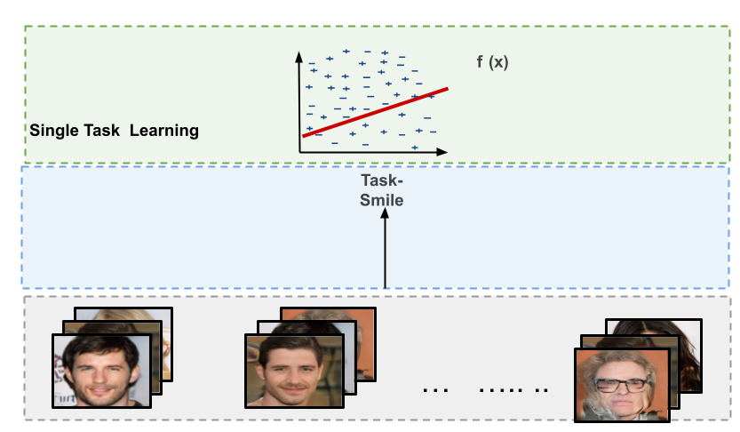
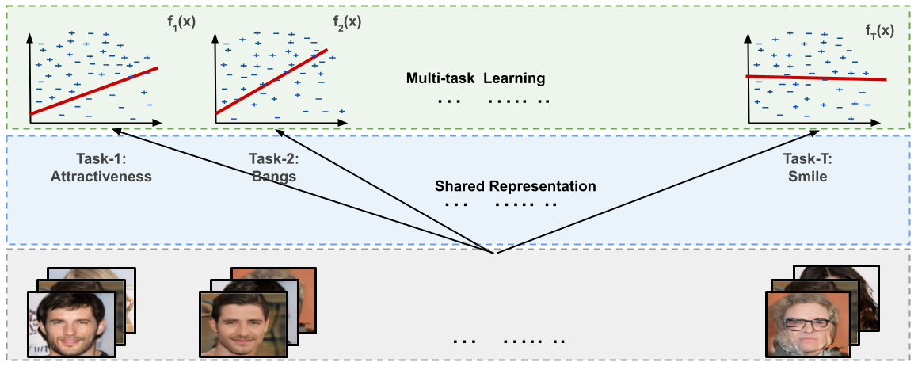
Single vs Multi-task Learning
STL
MTL
learn a single supervised prediction tasks (STL).
Learn multiple supervised prediction tasks concurrently (MTL).
Utilize a shared optimization space to enhance generalization across the tasks.

Slide 5
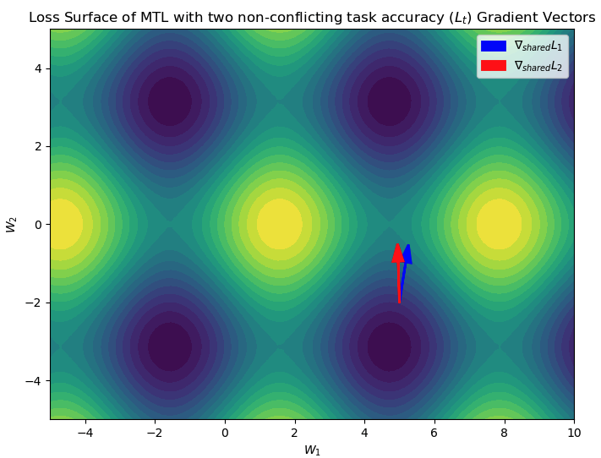
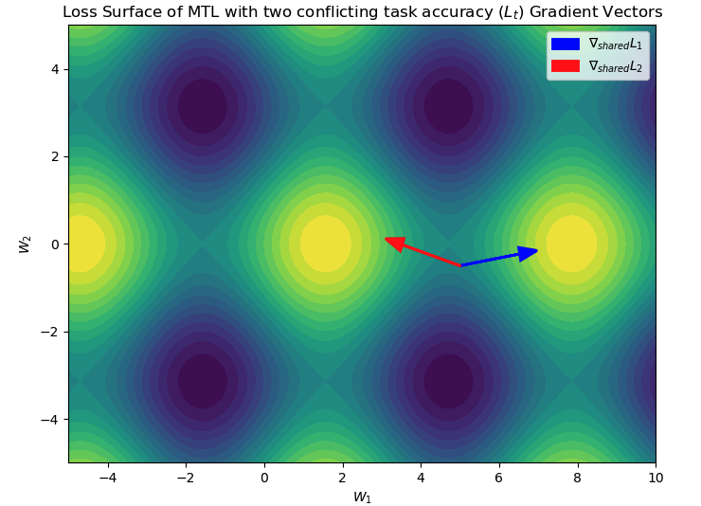
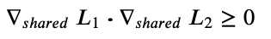
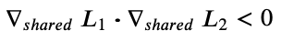
The Conflicting Gradient Problem
Hypothetical loss surface of the shared parameter space jointly trained with two task losses L₁ and L₂
Two task t1 (blue arrow), and t2 (red arrow) moving together:
in the same optimization direction
Two task t1 (blue arrow), and t2 (red arrow) moving towards:
respective local minima in conflicting direction

Slide 6
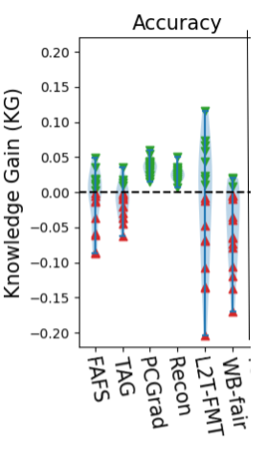
Gradient Conflict to Negative Transfer
CelebA [Liu et al., ICCV 15]
Knowledge Gain (KG): difference in accuracy between MTL (𝓜) and STL (𝓗) trained on t:
Ideal scenario: achieve non-negative (green triangles) , i.e., KG(t)≥0 for all t.
Negative Transfer: where KG(t)<0, (red triangles).
Root Cause: Research identified accuracy conflict as origin. [Guangyuan et al., ICLR 22; Yu et al., NeurIPS 20; Du et al., ContLearn 18] .
Tackle accuracy conflicts
FAFS [Lu et al., CVPR 17], TAG [Fifty et al., NeurIPS 21], PCGrad [Yu et al., NeurIPS 20],
Recon [Guangyuan et al., ICLR 22], L2TFMT [Roy et al., ECML 22], WB-fair~[Hu et al., ECML 23]

Slide 7
Problem Definition

Slide 8
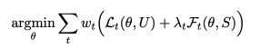
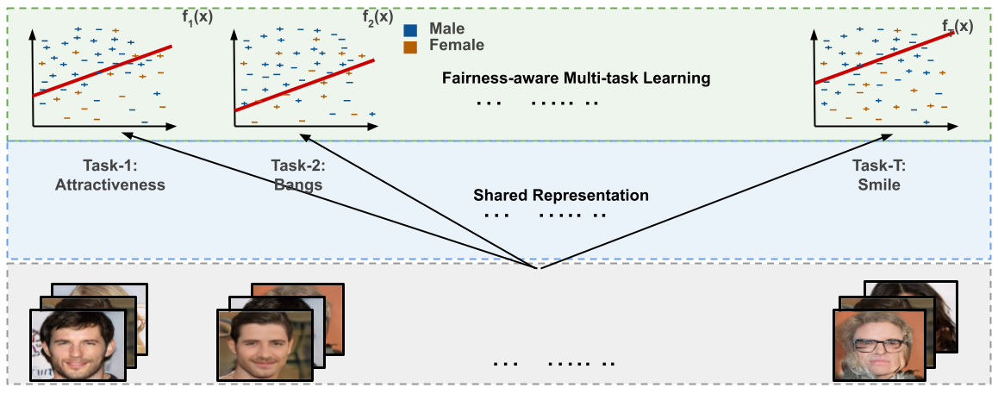
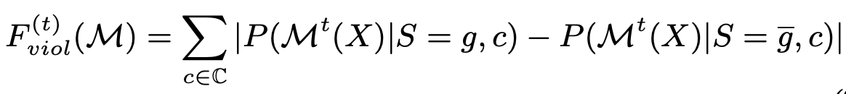
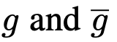
Fairness Issues in MTL
What is Fairness-aware MTL aka fair-MTL?
Requires to optimize minimum two losses [Roy et al., ECMLPKDD 22] per task t :
accuracy loss L_{t} and
fairness loss F_{t} .
𝝺 sets accuracy and fairness trade-off, ω sets the inter-task trade-off
learn multiple supervised prediction tasks without discrimination
≅0
represents groups like “male”, and “female”.

Slide 9
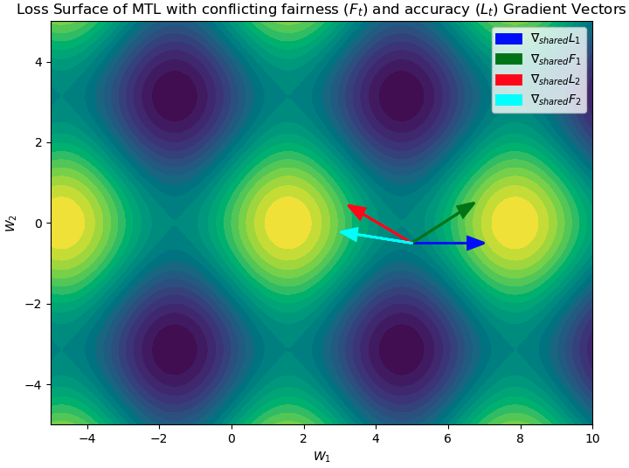
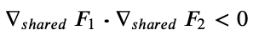
Fairness Issues in MTL
Exaggerated Conflict Gradient Problem in fair-MTL
Hypothetical loss surface of the shared parameter space jointly trained with two accuracy L₁ and L₂ , and two fairness F₁ and F₂ losses
Requires to optimize minimum two losses [Roy et al., ECMLPKDD 22] per task t :
accuracy loss L_{t} and
fairness loss F_{t} .
𝝺 sets accuracy and fairness trade-off, ω sets the inter-task trade-off
More conflicts to deal with
Introduces the fairness conflict problem

Slide 10
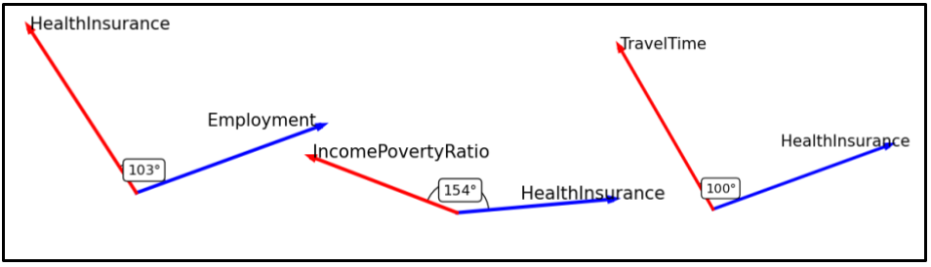
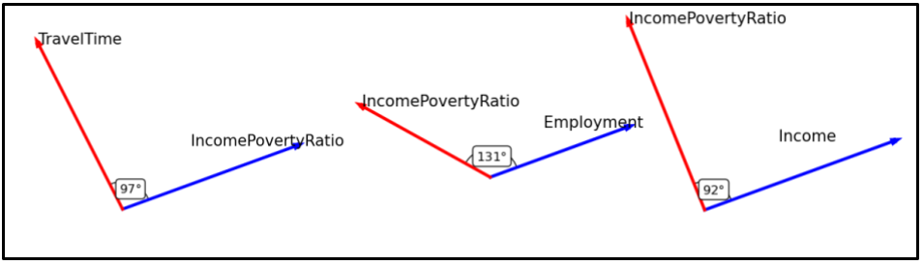
Fairness Conflict in SOTA MTL
Recon [Guangyuan et al., ICLR 22]
TAG [Fifty et al., NeurIPS 21]
Fairness conflict observed in SOTA MTL methods when trained on real world census data [Ding et al., NeurIPS 21].

Slide 11
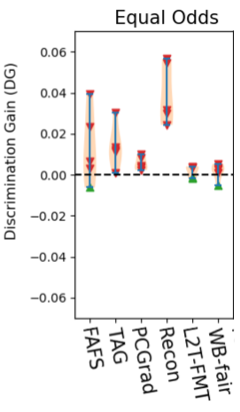
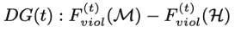
Fairness Conflict to Bias Transfer
ACS-PUMS [Ding et al., NeurIPS 21]
Discrimination Gain (DG): difference in fairness violation between MTL (𝓜) and STL (𝓗) trained on t:
Bias Transfer: where DG(t)>0 i.e., positive gain of discrimination (red triangles).
Ideal scenario: non-positive bias transfer, i.e., DG(t)≤0 (green triangles).
Root Cause: we hypothesize bias transfer originates from fairness conflict.
fair-MTLs

Slide 12
FairBranch

Slide 13
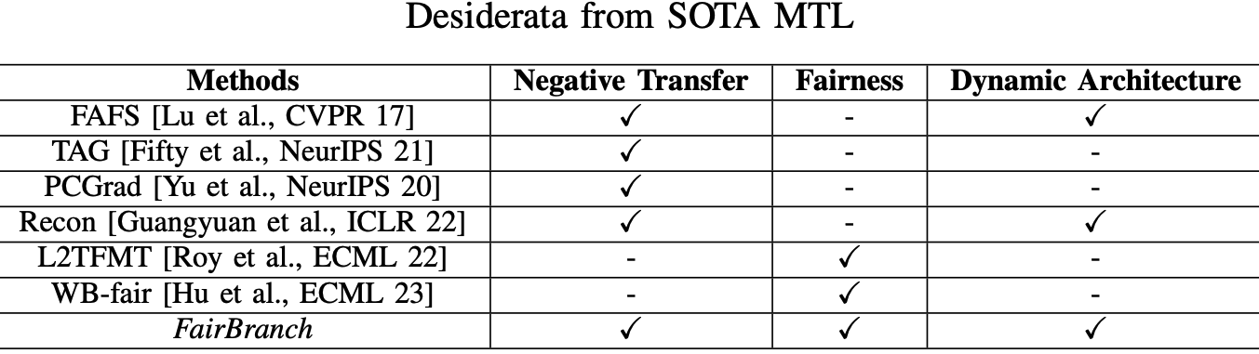
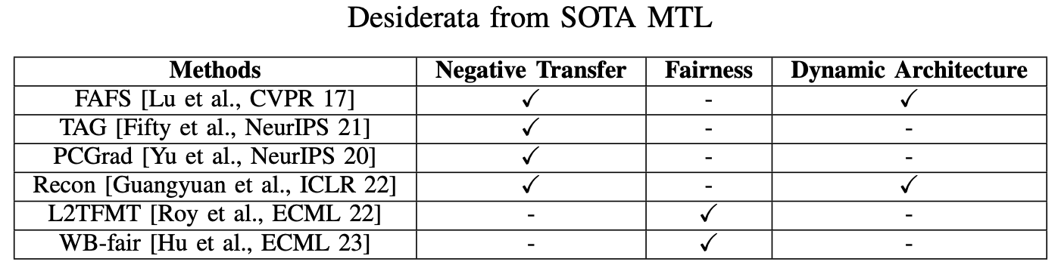
Desiderata from Related Research
Tackle accuracy conflicts
Tackle erroneous over-generalization
Tackle fairness conflicts

Slide 14
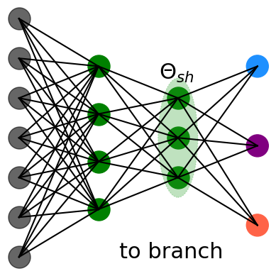
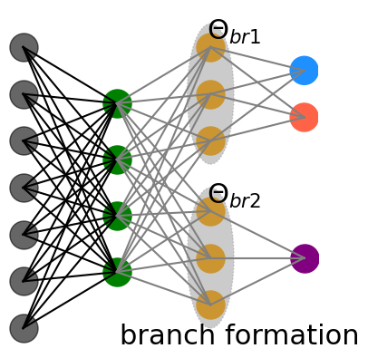
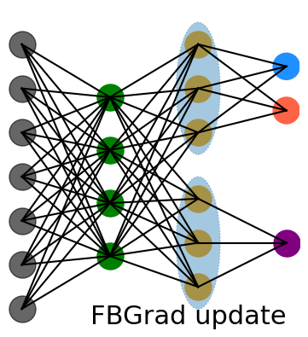
Mitigating Conflicts for fair-MTL
Groups Tasks on Parameter Similarity [Kornblith et al., ICML 19]:
Intuition - strong parameter similarity ensures similar direction of minima.
Expectation - move together without any conflict.
Addressing Negative Transfer
Branch Task Groups:
Intuition - similar tasks benefits from sharing more knowledge.
Expectation: sharing less with dissimilar tasks reduces over-generalization.
Addressing erroneous over-generalization
Conflict-free Fairness Correction:
Intuition - correcting the fairness conflict between task gradients within tasks groups ensures fair-MTL without Bias Transfer.
Addressing Bias Transfer

Slide 15
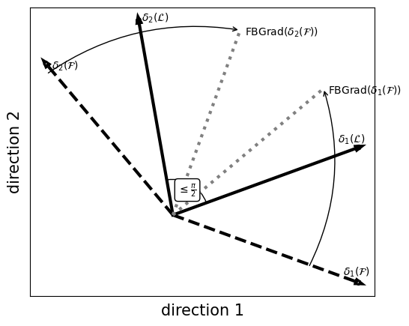
Mitigating Conflicts for fair-MTL
Hypothetical example of Fairness Gradient Conflict correction
Conflict-free Fairness Correction:
Intuition - correcting the fairness conflict between task gradients within tasks groups ensures fair-MTL without Bias Transfer.
Addressing Bias Transfer

Slide 16
Experiments

Slide 17
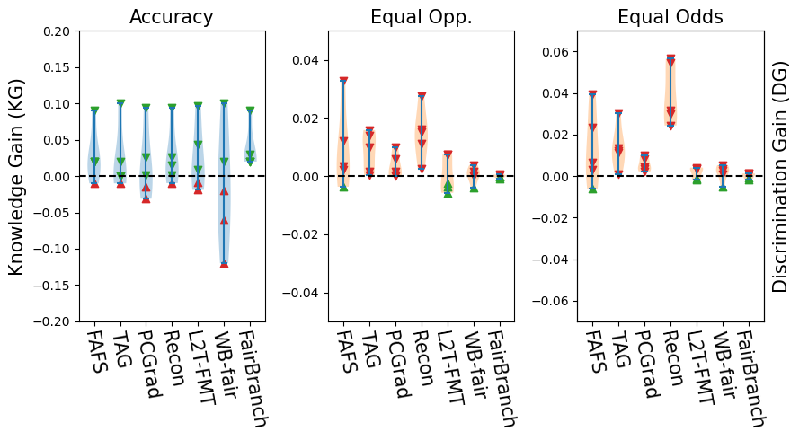
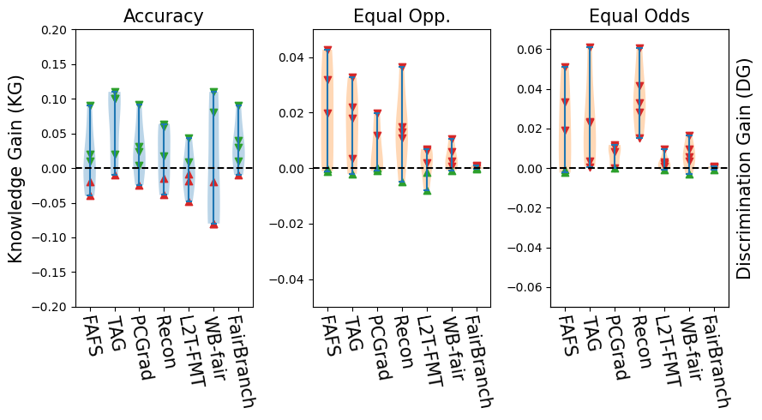
Comparative Results
Tabular Data: ACS-PUMS Census Data [Ding et al., NeurIPS 21]
ACS-PUMS 18-19
ACS-PUMS 19-21
Train on census 2018 and test on census 2019. Gender used as protected attribute.
# of tasks: 5
Train on census 2019 and test on census 2021. Gender used as protected attribute.
# of tasks: 5
FairBranch effectively tackles both negative transfer (non-negative KG) and bias transfer (non-positive DG).
Among competitors, conflict correction on parameter space (PCGrad, Recon) outperform other on negative transfer.

Slide 18
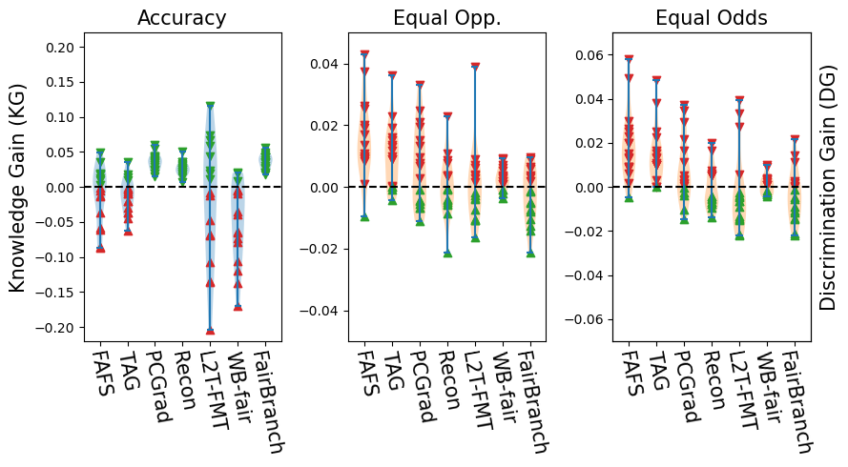
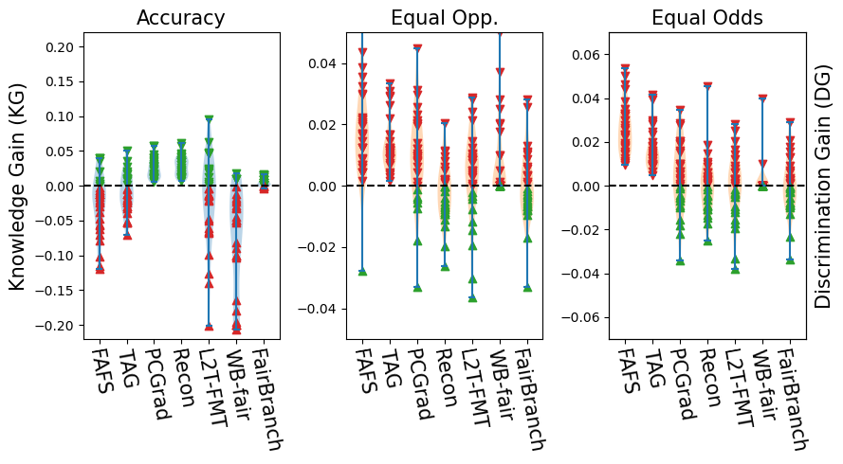
Comparative Results
Visual Data: CelebA Data [Liu et al., ICCV 15]
CelebA gen
CelebA age
Gender used as protected attribute
# of tasks 17
Age used as protected attribute
# of tasks 31
FairBranch effectively tackles negative transfer (non-negative KG), but suffers from bias transfer (positive DG) in some tasks.
Among competitors, conflict correction on parameter space (PCGrad, Recon) outperform other on negative transfer.

Slide 19
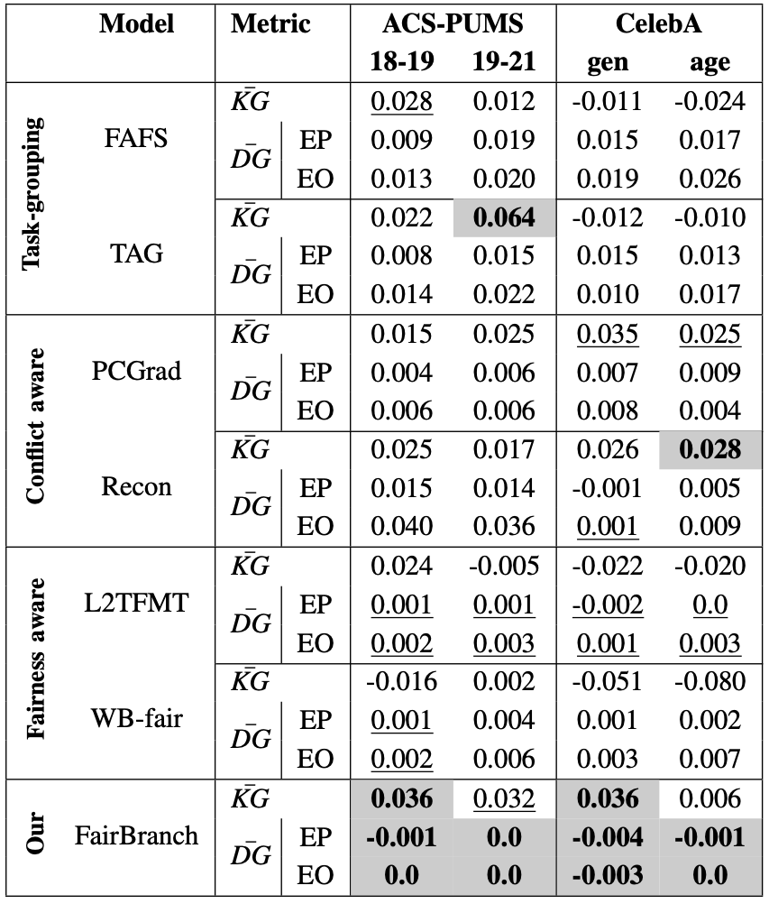
Comparative Results
Reporting on the average Knowledge Gain (KG) and average Discrimination Gain (DG) :
FairBranch outperforms all the competitors on 10 out of 12 evaluation report.
In all experiment FairBranch have average Knowledge Gain > 0, and average Discrimination Gain ≤ 0.
In visual data even under large # of tasks, SOTA MTLs like TAG, FAFS fails, FairBranch consistently positive on Knowledge Gain.
Similar findings for fairness against SOTA fair-MTL observed with L2TFMT, WB-fair on Discrimination Gain.

Slide 20
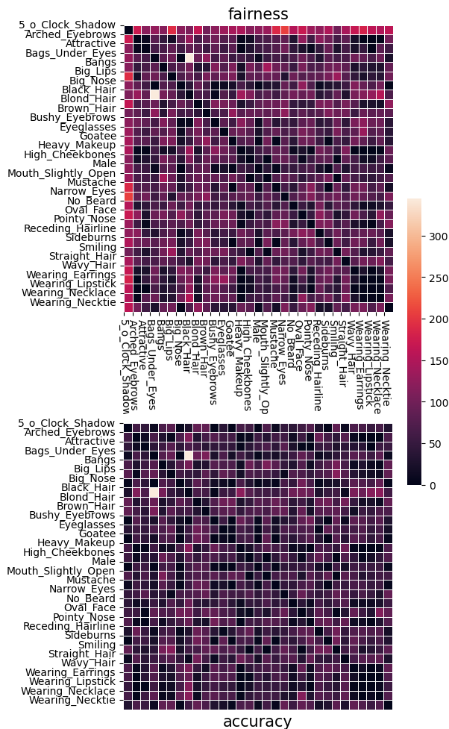
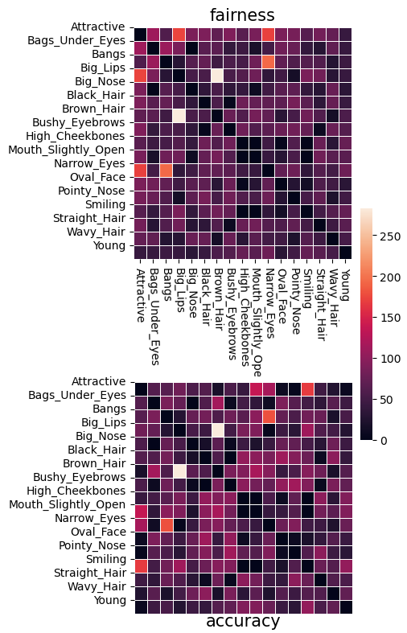
Conflict Analysis of FairBranch
Conflict Heatmaps :
tasks like ‘Attractive’ and ‘5 o Clock shadow’ have fewer accuracy conflicts but many fairness conflicts across all tasks.
CelebA Gender
CelebA Age

Slide 21
Discussion and Conclusion

Slide 22
Key Takeaways
FairBranch tackles negative transfer and bias transfer better than the competitors.
FairBranch outperforms the competitors on average knowledge and discrimination gain.
Tackling negative transfer on parameter space is advantageous over on output (loss) space.
Learning fair multi-task learning (MTL) is challenging due to the complex decisions required, as certain tasks contribute positively to accuracy knowledge transfer while hindering fairness knowledge transfer.

Slide 23
References
F. Ding, M. Hardt, J. Miller, and L. Schmidt, “Retiring adult: New datasets for fair machine learning,” NeurIPS, vol. 34, 2021.
Y. Du, W. M. Czarnecki, S. M. Jayakumar, M. Farajtabar, R. Pascanu, and B. Lakshminarayanan, “Adapting auxiliary losses using gradient similarity,” Continual learning Workshop at NeurIPS 2018.
C. Fifty, E. Amid, Z. Zhao, T. Yu, R. Anil, and C. Finn, “Efficiently identifying task groupings for multi-task learning,” NeurIPS, vol. 34, pp. 27 503–27 516, 2021.
S. Guangyuan, Q. Li, W. Zhang, J. Chen, and X.-M. Wu, “Recon: Reducing conflicting gradients from the root for multi-task learning,” in 11th ICLR, 2022.
M. Hardt, E. Price, and N. Srebro, “Equality of opportunity in supervised learning,” NeurIPS, vol. 29, pp. 3315–3323, 2016.
F. Hu, P. Ratz, and A. Charpentier, “Fairness in multi-task learning via wasserstein barycenters,” in ECMLPKDD. Springer, 2023, pp. 295–312.
S. Kornblith, M. Norouzi, H. Lee, and G. Hinton, “Similarity of neural network representations revisited,” in ICML, 2019, pp. 3519–35.
Z. Liu, P. Luo, X. Wang, and X. Tang, “Deep learning face attributes in the wild,” in ICCV, December 2015.
A. Roy and E. Ntoutsi, “Learning to teach fairness-aware deep multi-task learning,” in ECMLPKDD. Springer, 2022, pp. 710–726.
T. Yu, S. Kumar, A. Gupta, S. Levine, K. Hausman, and C. Finn, “Gradient surgery for multi-task learning,” NeurIPS, vol. 33, pp. 5824–5836, 2020.

Slide 24

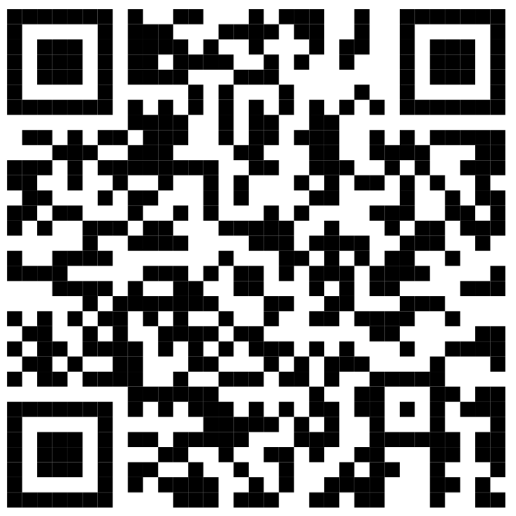
Thank you for your attention
Question??
Find me via: Google Scholar, Github, LinkedIn, YouTube
arjun.roy@unibw.de
For more details about FairBranch:
https://arjunroyihrpa.github.io/FairBranch/
This work is supported by:
European Horizon Project MAMMOth
EU HORIZON-RIA Project ID:101070285

